Slide 1
EMTH403
Mathematical Foundation for Computer Science

Slide 2
Lecture Outcomes
understand how to represent relations using digraphs
understand what is a Hasse Diagraph/Diagram

Slide 3
Representing Relations Using Digraphs
A directed graph, or digraph, consists of a set V of vertices (or nodes) together with a set E of ordered pairs of elements of V called edges (or arcs).

Slide 4
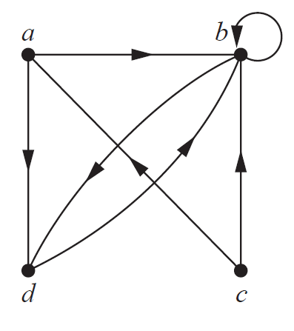
Representing Relations Using Digraphs
The vertex a is called the initial vertex of the edge (a, b), and the vertex b is called the terminal vertex of this edge.

Slide 5
Representing Relations Using Digraphs
An edge of the form (a, a) is represented using an arc from the vertex a back to itself.
Such an edge is called a loop.

Slide 6
Representing Relations Using Digraphs
The directed graph with vertices a, b, c, and d, and edges (a, b), (a, d), (b, b), (b, d), (c, a), (c, b), and (d, b) is displayed in Figure below.

Slide 7
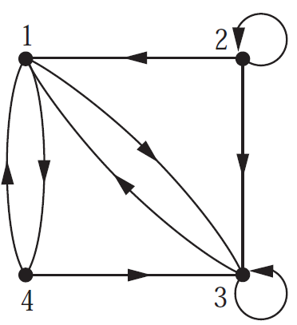
Representing Relations Using Digraphs
The directed graph of the relation
R = {(1, 1), (1, 3), (2, 1), (2, 3), (2, 4), (3, 1), (3, 2), (4, 1)}
on the set {1, 2, 3, 4} is shown in Figure below.

Slide 8
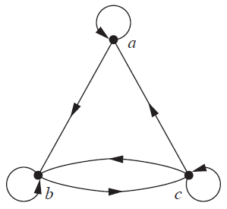
Representing Relations Using Digraphs
Determine whether the relations for the directed graphs shown in Figure below is reflexive.
Because there are loops at every vertex of the directed graph of R, it is reflexive.

Slide 9
Representing Relations Using Digraphs
Determine whether the relations for the directed graphs shown in Figure below is symmetric.
R is not symmetric because there is an edge from a to b but not one from b to a.

Slide 10
Representing Relations Using Digraphs
Determine whether the relations for the directed graphs shown in Figure below are antisymmetric.
R is not antisymmetric because there are edges in both directions connecting b and c.

Slide 11
Representing Relations Using Digraphs
Determine whether the relations for the directed graphs shown in Figure below is transitive.
R is not transitive because there is an edge from a to b and an edge from b to c, but no edge from a to c.

Slide 12
Hasse Diagrams
Many edges in the directed graph for a finite poset do not have to be shown because they must be present.

Slide 13
Hasse Diagrams
Step 1:- Start with a directed graph of the relation in which all arrows point upward,
Step 2:- Eliminate: the loops at all the vertices,
Step 3:- Eliminate: all arrows whose existence is implied by the transitive property,
Step 4:- Eliminate: the direction indicators on the arrows.

Slide 14
Hasse Diagrams – Example 1
Let A = {1, 2, 3, 15, 30} and consider the “divides” relation on A:
For all
30
15
2
3
1

Slide 15
Hasse Diagrams – Example 1
Eliminate the loops at all the vertices.
Eliminate all arrows whose existence is implied by the transitive property.
Eliminate the direction indicators on the arrows.
30
15
2
3
1

Slide 16
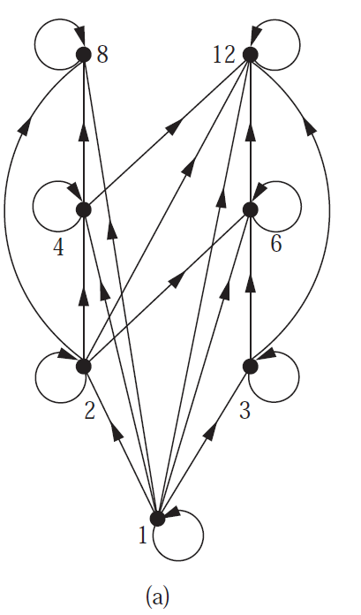
Hasse Diagrams – Example 2
Draw the Hasse diagram representing the partial ordering {(a, b) |a divides b} on {1, 2, 3, 4, 6, 8, 12}.

Slide 17
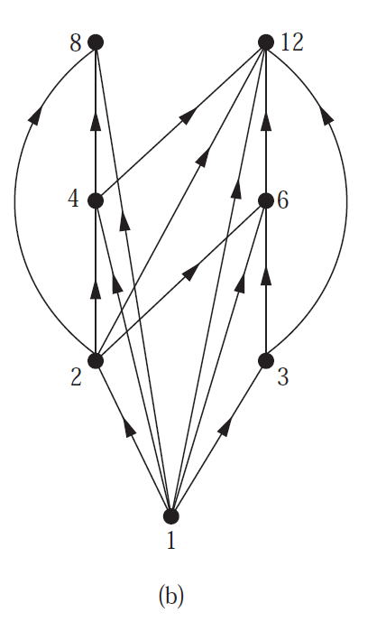
Hasse Diagrams – Example 2
Remove all loops, as shown in Figure 3(b).
Then delete all the edges implied by the transitive property.

Slide 18
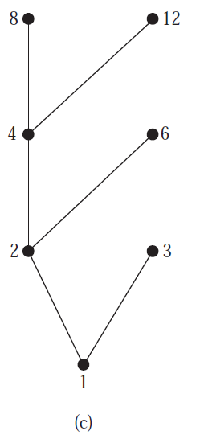
Hasse Diagrams – Example 2
Arrange all edges to point upward, and delete all arrows
to obtain the Hasse diagram.
The resulting Hasse diagram is shown in Figure 3(c).

Slide 19
Hasse Diagrams – Example 3
Draw the Hasse diagram for inclusion on the set P(S), where S = {a, b, c}.
P(S)={∅, {a}, {b}, {c}, {a, b}, {a, c}, {b, c}, {a, b, c}}

Slide 20
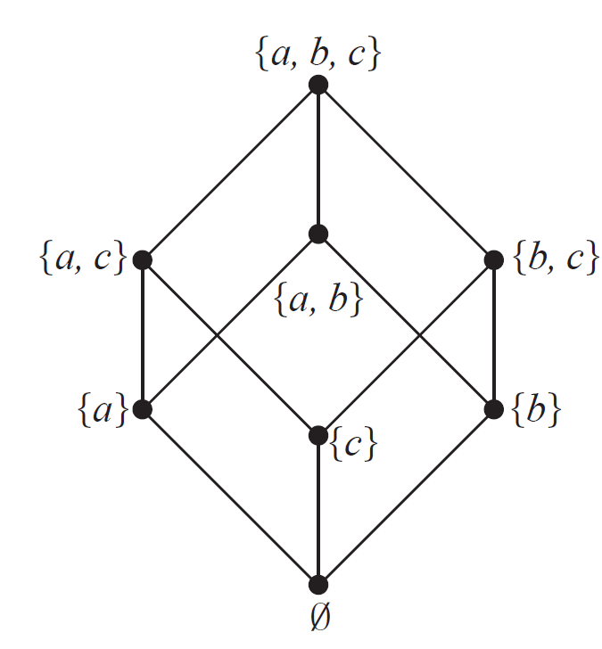
Hasse Diagrams – Example 3
The Hasse Diagram of (P ({a, b, c}),⊆) is given below.

